Slide 1

Teaching Your Kids Programming with
Lesson 2

Slide 2
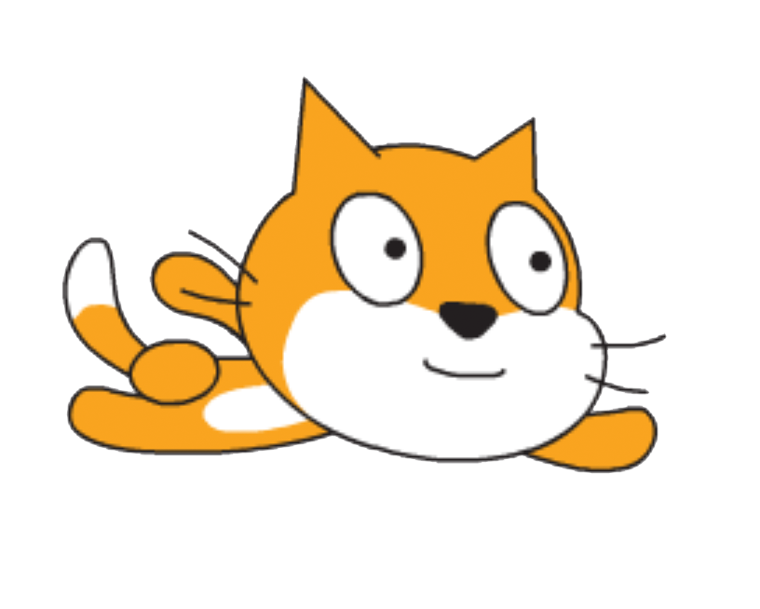
Previously
Motivation
Made fly
Example of completed lesson: https://scratch.mit.edu/projects/275716807/
Coming up
Making a game from the flying

Slide 3
Elements of the game
Ability to move
A point system
Rule for losing points
Rules for ending the game
A way to shoot “lasers”
Rule for gaining points
High score

Slide 4
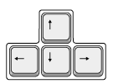
Making the cat move
Moving up
Moving down
Moving to the right
Moving to the left

Slide 5
Adding a point system
From Variables, make a new variable for all sprites called “points”
In the character script area
Add between “go to front” and “say … for 2 secs” and change it to set points to 10

Slide 6
Decreasing points
To make the points drop, we can consider that hitting the building hurts our character
Drag the following elements:
Make:
This ends up as a problem:

Slide 7
Ending the game
Avoid getting to -∞
Drag under the if block
To make:

Slide 8

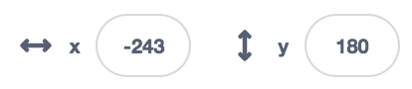
Shooting lasers
Create a new sprite, Button2: / (you can shrink it if it looks too big)
Add the following script to the cat script area:
We don’t want to see the laser when the space key is not pressed, so we can hide this sprite:
We should also place it somewhere else:

Slide 9
Making the laser move when it’s created
In Button2’s script area:
Add:
This will make the laser shoot straight ahead
Optionally, you can modify it to control the button with your mouse:

Slide 10
Making points by clearing clouds
In Button2’s script area:
Add under the existing in the repeat block
We want the clouds to clear when we shoot them
In Clouds’ script area:
Replace the existing repeat block with:

Slide 11
Creating a high score
Make another variable called “high score”
Add the following to the character’s script area:
If there is the need to reset the high score, we can create that option:

Slide 12
https://scratch.mit.edu/projects/277348682/

Slide 13
Resources:
Tutorials
Forums
Online examples
Shared projects
Just trying out things

Slide 14
Find more projects to try
https://scratch.mit.edu/explore/projects/all
Categories to choose from:
Animations
Art
Games
Music
Stories

